Slide 1
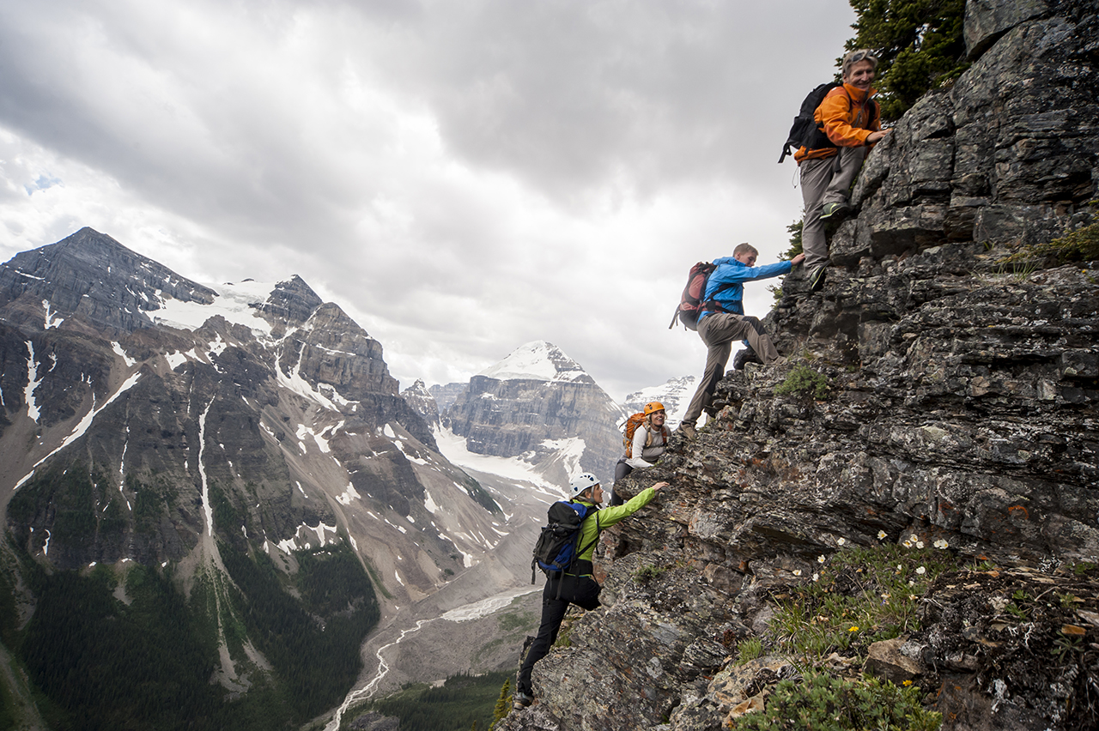
Philippians 3:12-16
Journeying Toward Christlikeness!
Dan Bridges Amman International Church, Jordan (AmmanChurch.org) Uploaded by Dr. Rick Griffith • Jordan Evangelical Theological Seminary Files in many languages for free download at BibleStudyDownloads.org

Slide 2
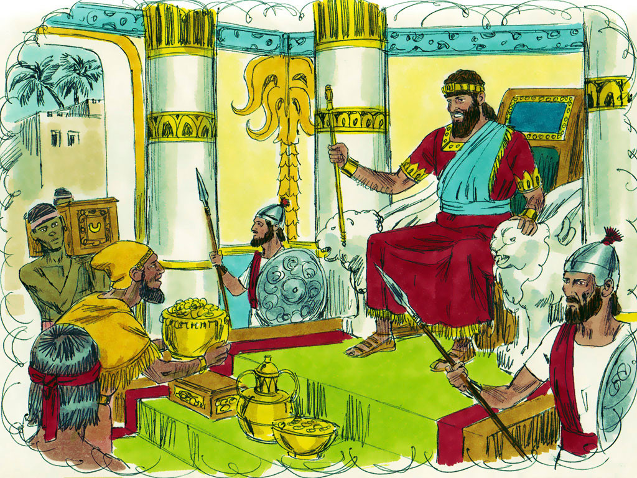
Ask for whatever you want me to give you. 2 Chronicles 1:7

Slide 3
When given the chance to ask God for one thing, what did King Solomon ask for?

Slide 4
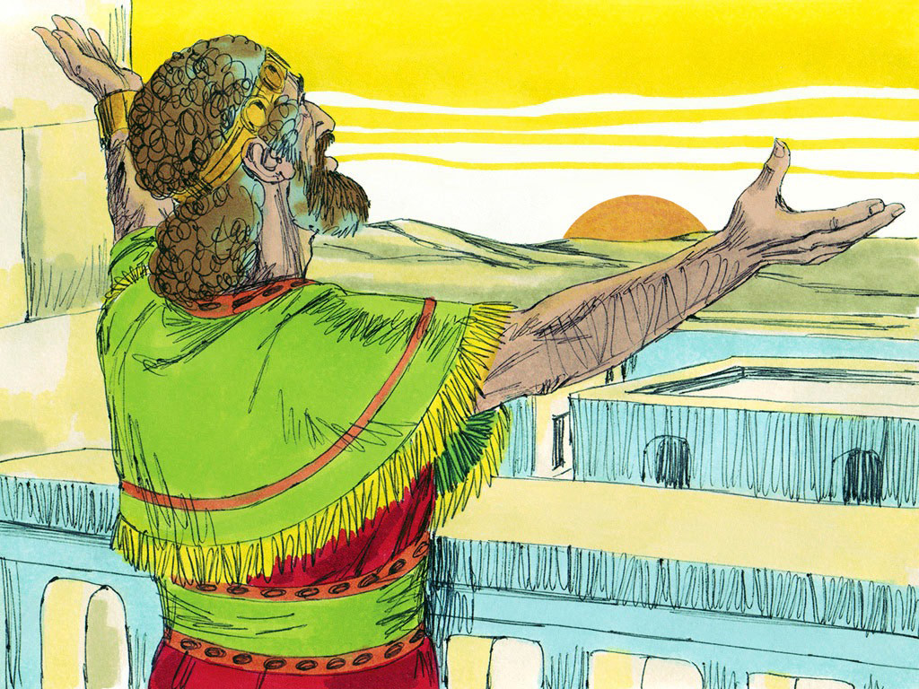
What do you think his father, King David, would have asked God for?

Slide 5
One thing I ask of the Lord,
this will I seek:
that I may dwell in the house of the Lord
all the days of my life,
to gaze upon the beauty of the Lord
and to seek him in his temple.
Psalm 27:4

Slide 6
If given the same opportunity, what would you ask for?

Slide 7
How do we get to the point where God himself is the desire of our hearts?

Slide 8
¹² Not that I have already obtained it or have already become perfect, but I press on so that I may lay hold of that for which also I was laid hold of by Christ Jesus. ¹³ Brethren, I do not regard myself as having laid hold of it yet; but one thing I do: forgetting what lies behind and reaching forward to what lies ahead, ¹⁴ I press on toward the goal for the prize of the upward call of God in Christ Jesus.
Philippians 3:12-14

Slide 9
15 Let us therefore, as many as are perfect, have this attitude; and if in anything you have a different attitude, God will reveal that also to you; 16 however, let us keep living by that same standard to which we have attained.
Philippians 3:15-16

Slide 10
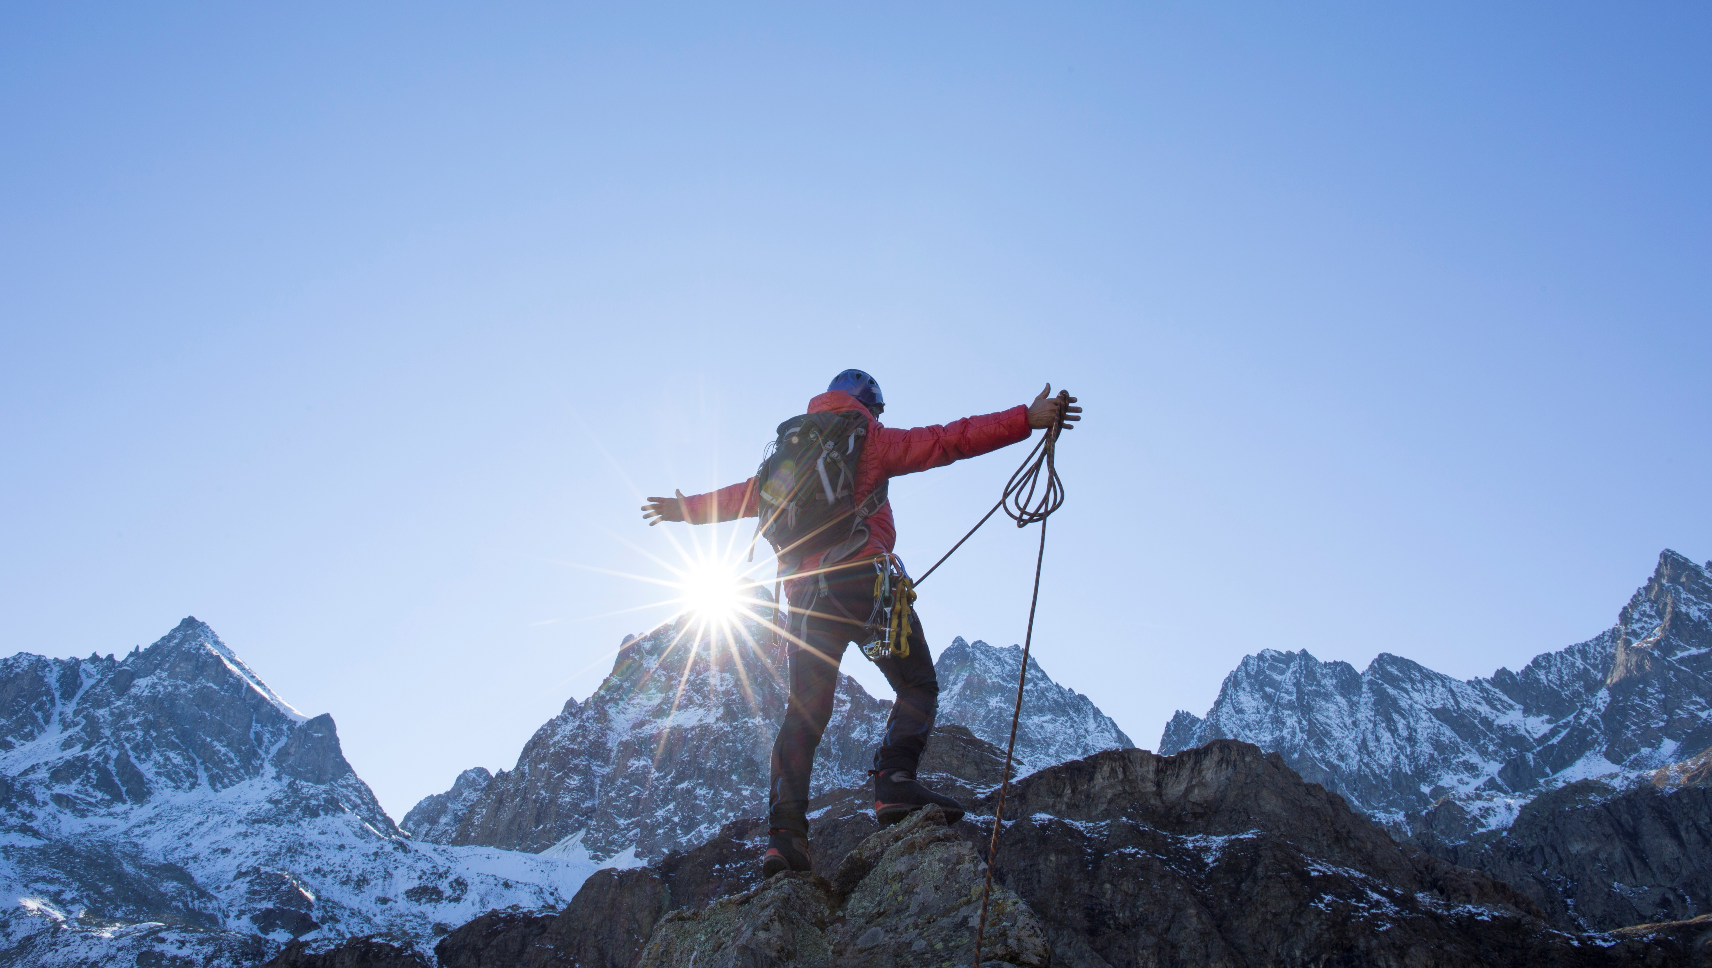
Main Idea:
God’s purpose for us as believers is that we become completely Christlike!
Is that your purpose for yourself?
Notes:
Make being like Jesus your highest priority!

Slide 11
Becoming Christlike
Believe what God says about us
Commit to the method he has given us
Recognize each person’s unique journey
Notes:
It is in knowing Jesus that we can know God!

Slide 12
1. Believe What God Says about Us
¹² Not that I have already obtained it or have already become perfect, but I press on so that I may lay hold of that for which also I was laid hold of by Christ Jesus. ¹³ Brethren, I do not regard myself as having laid hold of it yet; but one thing I do: forgetting what lies behind and reaching forward to what lies ahead,
Philippians 3:12-13

Slide 13
¹⁰ that I may know him and the power of his resurrection, and may share his sufferings, becoming like him in his death, ¹¹ that by any means possible I may attain the resurrection from the dead. ¹² Not that I have already obtained it or have already become perfect…
Philippians 3:10-12

Slide 14
That I May Know Him
This is a knowledge of Christ that
Is Intimate and personal
Changes us
Inspires us to know him more

Slide 15
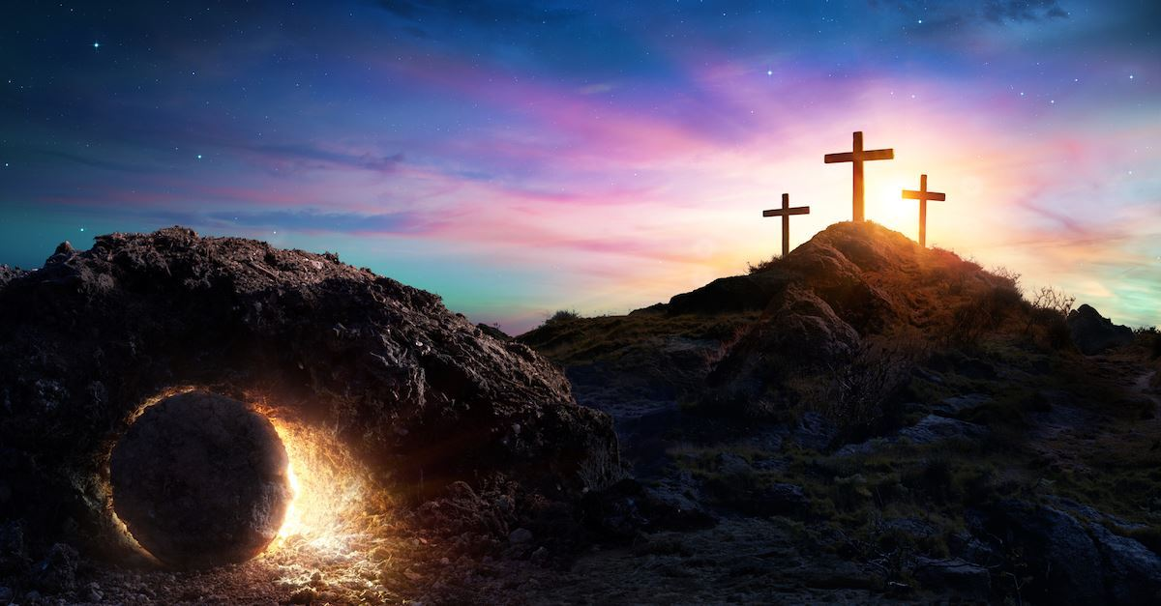
The Power of his Resurrection
Experiencing God’s miraculous power to
Change our hearts and character
Gift and equip us for ministry

Slide 16
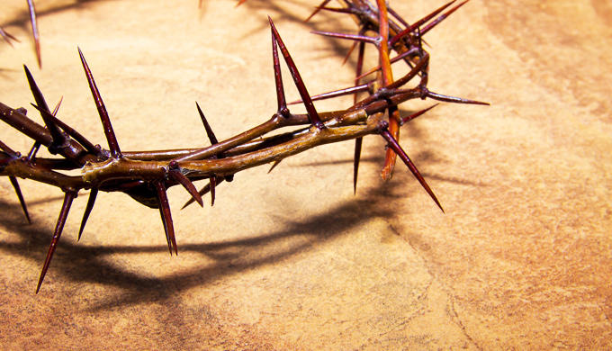
Sharing in His Suffering /
Becoming Like Him in His Death
Embracing God’s plan
That Christ came to suffer
That we also suffer as we obey
That we come to know Christ more intimately through this

Slide 17
What has Paul not yet obtained?
Complete knowledge of Christ
Complete experience of his power
Complete sharing with Christ in suffering
Complete transformation of his life

Slide 18
1. Believe What God Says about Us
¹² Not that I have already obtained it or have already become perfect, but I press on so that I may lay hold of that for which also I was laid hold of by Christ Jesus. ¹³ Brethren, I do not regard myself as having laid hold of it yet; but one thing I do: forgetting what lies behind and reaching forward to what lies ahead,
Philippians 3:12-13
God says that we are not yet completely Christlike or mature.

Slide 19
1. God says that we are not yet completely Christlike or mature.
Is it enough to say,
“Of course… I am not perfect!”
Can you answer the question,
“How, specifically, are you not Christlike?”

Slide 20
1. God says that we are not yet completely Christlike or mature.
What are some situations when I’m proud?
When do I not display love, joy, peace, patience, kindness, gentleness, faithfulness, self-control?
How about bitterness, wrath, anger, slander?
How does my family wish I was different?
God says that we are not yet completely Christlike or mature.
Notes:
Are you aware of specific sins in your life? How do those make you feel? Defeated because YOU have “failed”? Grieved because you have sinned against the One who has died for you?

Slide 21
1. Believe What God Says about Us
¹² Not that I have already obtained it or have already become perfect, but I press on so that I may lay hold of that for which also I was laid hold of by Christ Jesus. ¹³ Brethren, I do not regard myself as having laid hold of it yet; but one thing I do: forgetting what lies behind and reaching forward to what lies ahead,
Philippians 3:12-13
He chose us in him before the creation of the world, that we should be holy and blameless before him. Ephesians 1:4

Slide 22
1. Believe What God Says about Us
God has saved us for the purpose of our becoming completely Christlike.

Slide 23
1. Believe What God Says about Us
God says we are not yet completely Christlike
God says that he has saved us for the purpose of our becoming completely Christlike

Slide 24
Becoming Christlike
Believe what God says about us
Commit to the method he has given us
Recognize each person’s unique journey
Notes:
It is in knowing Jesus that we can know God!

Slide 25
2. Commit to the Method He has Given Us
¹² Not that I have already obtained it or have already become perfect, but I press on so that I may lay hold of that for which also I was laid hold of by Christ Jesus. ¹³ Brethren, I do not regard myself as having laid hold of it yet; but one thing I do: forgetting what lies behind and reaching forward to what lies ahead, ¹⁴ I press on toward the goal for the prize of the upward call of God in Christ Jesus.
Philippians 3:12-14

Slide 26
2. Commit to the Method He has Given Us
¹² Not that I have already obtained it or have already become perfect, but I press on so that I may lay hold of that for which also I was laid hold of by Christ Jesus. ¹³ Brethren, I do not regard myself as having laid hold of it yet; but one thing I do: forgetting what lies behind and reaching forward to what lies ahead, ¹⁴ I press on toward the goal for the prize of the upward call of God in Christ Jesus.
Philippians 3:12-14

Slide 27
2. Commit to the Method He has Given Us
¹² Not that I have already obtained it or have already become perfect, but I press on so that I may lay hold of that for which also I was laid hold of by Christ Jesus. ¹³ Brethren, I do not regard myself as having laid hold of it yet; but one thing I do: forgetting what lies behind and reaching forward to what lies ahead, ¹⁴ I press on toward the goal for the prize of the upward call of God in Christ Jesus.
Philippians 3:12-14

Slide 28
2. Commit to the Method He has Given Us
¹² Not that I have already obtained it or have already become perfect, but I press on so that I may lay hold of that for which also I was laid hold of by Christ Jesus. ¹³ Brethren, I do not regard myself as having laid hold of it yet; but one thing I do: forgetting what lies behind and reaching forward to what lies ahead, ¹⁴ I press on toward the goal for the prize of the upward call of God in Christ Jesus.
Philippians 3:12-14

Slide 29
2. Commit to the Method He has Given Us
¹² Not that I have already obtained it or have already become perfect, but I press on so that I may lay hold of that for which also I was laid hold of by Christ Jesus. ¹³ Brethren, I do not regard myself as having laid hold of it yet; but one thing I do: forgetting what lies behind and reaching forward to what lies ahead, ¹⁴ I press on toward the goal for the prize of the upward call of God in Christ Jesus.
Philippians 3:12-14
God’s method for us is that we put extraordinary effort into becoming Christlike!

Slide 30
What does “Extraordinary Effort” Look Like?
“Press On…” – Greek dioko
To pursue earnestly, to press hard after, to persecute (vs 6)

Slide 31
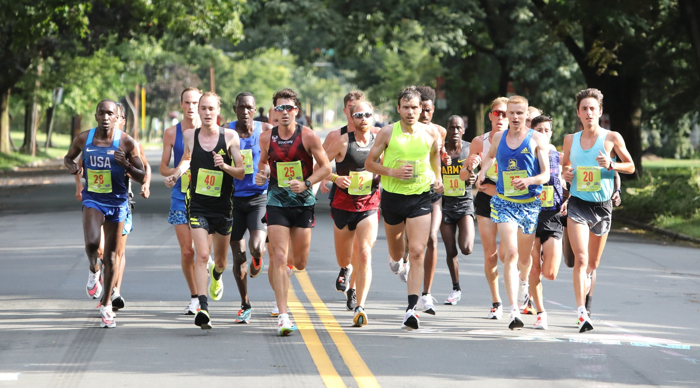
What does “Extraordinary Effort” Look Like?
“Forgetting what is behind…”
What’s Behind Us?
Other runners – the temptation to compare ourselves to others
Past Failures – the temptation to become discouraged or quit
Past Successes – the temptation to rely on past spiritual growth

Slide 32
What does “Extraordinary Effort” Look Like?
“Reaching forward to what lies ahead…”
What’s Ahead of Us?
Marathon – not a sprint!
Short-term – Honestly assessing our current spiritual needs (contentment, joy, family relationships, integrity, walk with God, etc.)

Slide 33
What does “Extraordinary Effort” Look Like?
“Reaching forward to what lies ahead…”
What’s Ahead of Us?
Long-term – Positioning ourselves for growth for years to come (establishing healthy spiritual community, establishing healthy spiritual habits, eliminating idols that are consuming us, etc.)

Slide 34
What does “Extraordinary Effort” Look Like?
“Press on toward the goal…”
What is the goal?
Christlikeness!

Slide 35
What does “Extraordinary Effort” Look Like?
“Press on toward the goal…”
What holds us back?

Slide 36
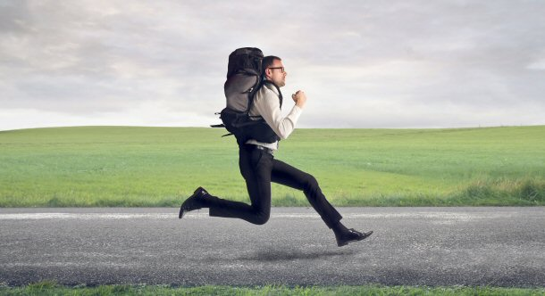
What does “Extraordinary Effort” Look Like?
Sinful habits
Bitterness
Pride / Unteachable spirit
Isolation
Other priorities
What is keeping you from growing in Christlikeness?
…let us throw off everything that hinders and the sin that so easily entangles… Hebrews 12:2

Slide 37
What does “Extraordinary Effort” Look Like?
“Press on toward the goal…”
What keeps us going?

Slide 38
2. Commit to the Method He has Given Us
¹² Not that I have already obtained it or have already become perfect, but I press on so that I may lay hold of that for which also I was laid hold of by Christ Jesus. ¹³ Brethren, I do not regard myself as having laid hold of it yet; but one thing I do: forgetting what lies behind and reaching forward to what lies ahead, ¹⁴ I press on toward the goal for the prize of the upward call of God in Christ Jesus.
Philippians 3:12-14
What’s the prize? Is it really worth all this effort?

Slide 39
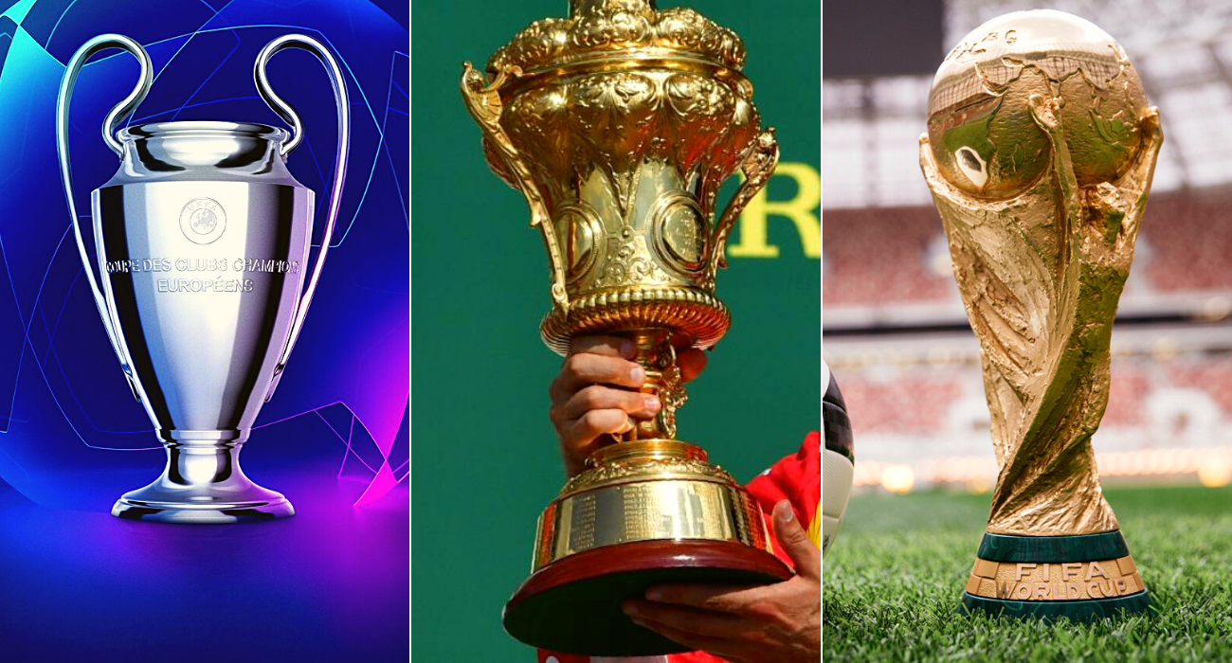
What Prize Could Be Worth All This Effort???
What is more, I consider everything a loss compared to the surpassing greatness of knowing Christ Jesus my Lord, for whose sake I have lost all things.
Philippians 3:8

Slide 40
What Prize Could Be Worth All This Effort???
One thing I ask of the Lord,
this will I seek:
that I may dwell in the house of the Lord
all the days of my life,
to gaze upon the beauty of the Lord
and to seek him in his temple.
Psalm 27:4

Slide 41
What Prize Could Be Worth All This Effort???
I say to the Lord, “You are my Lord;
I have no good apart from you.”
You make known to me the path of life;
in your presence there is fullness of joy;
at your right hand are pleasures forevermore.
Psalm 16:2,11

Slide 42
Why is Jesus the Ultimate Prize?
Anything we could ever seek after as a prize is already ours in Christ!
Happiness, Eternal Riches, Wisdom, Position, Physical pleasure, Comfort, Satisfaction, Love

Slide 43
2. Commit to the Method He has Given Us
God’s method for us is that we put extraordinary effort into becoming Christlike!

Slide 44
Becoming Christlike
Believe what God says about us
Commit to the method he has given us
Recognize each person’s unique journey
Notes:
It is in knowing Jesus that we can know God!

Slide 45
Recognize Each Person’s Unique Journey
15 Let us therefore, as many as are perfect, have this attitude; and if in anything you have a different attitude, God will reveal that also to you; 16 however, let us keep living by that same standard to which we have attained.
Philippians 3:15-16
Spiritually mature believers will agree on the principles Paul has described in verses 10-14 – a single-minded devotion to Christ.

Slide 46
Recognize Each Person’s Unique Journey
15 Let us therefore, as many as are perfect, have this attitude; and if in anything you have a different attitude, God will reveal that also to you; 16 however, let us keep living by that same standard to which we have attained.
Philippians 3:15-16
Paul’s confidence: That God was still at work in the hearts of true believers who weren’t there yet – those who still struggled with earthly pursuits.

Slide 47
Recognize Each Person’s Unique Journey
15 Let us therefore, as many as are perfect, have this attitude; and if in anything you have a different attitude, God will reveal that also to you; 16 however, let us keep living by that same standard to which we have attained.
Philippians 3:15-16
Paul recognized growth in their lives. Though we haven’t “arrived”, let’s recognize the significance of stages of our growth we and others have attained!

Slide 48
Becoming Christlike
Believe what God says about us
Commit to the method he has given us
Recognize each person’s unique journey
Notes:
It is in knowing Jesus that we can know God!

Slide 49
Main Idea:
God’s purpose for us as believers is that we become completely Christlike!
Is that your purpose for yourself?

Slide 51
NT Preaching link at BibleStudyDownloads.org
Get this presentation for free!
Notes:
NT Preaching (np)

